Slide 2
^{DISCIPLINA MIEA} ²⁰¹⁸

Slide 3
Mobilidade Sustentável

Slide 4
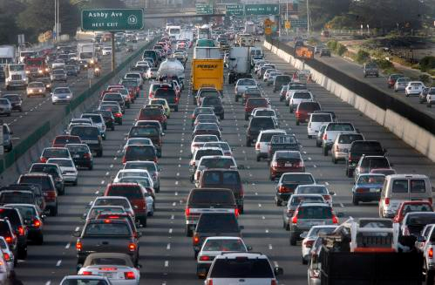
Energy and emissions
Home Work/ University
Commuting by motorized or soft modes
on a regular basis
Emissions
Energy

Slide 5
Emissions g/km
EMEP/EEA air pollutant emission inventory guidebook

Slide 6
Emissions g/km
EMEP/EEA air pollutant emission inventory guidebook
Not electric rail!

Slide 7
Emissions g/km

Slide 8
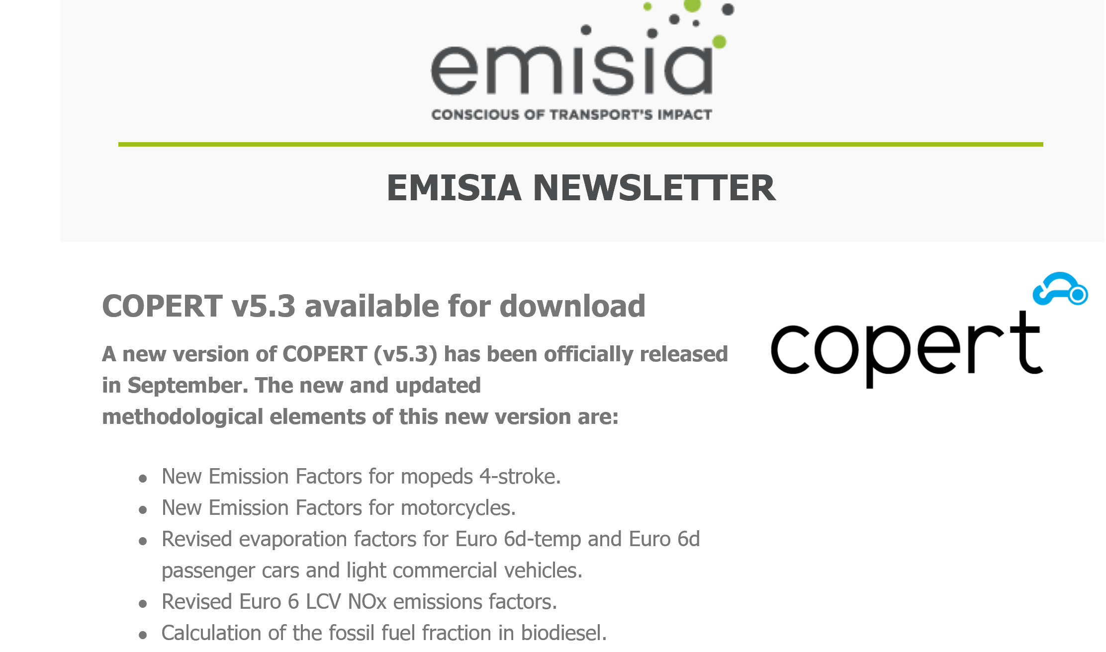
Surveys, energ. & emissions
https://www.emisia.com/utilities/copert/download/
Tier 3
8
Notes:
É energetic
8

Slide 9
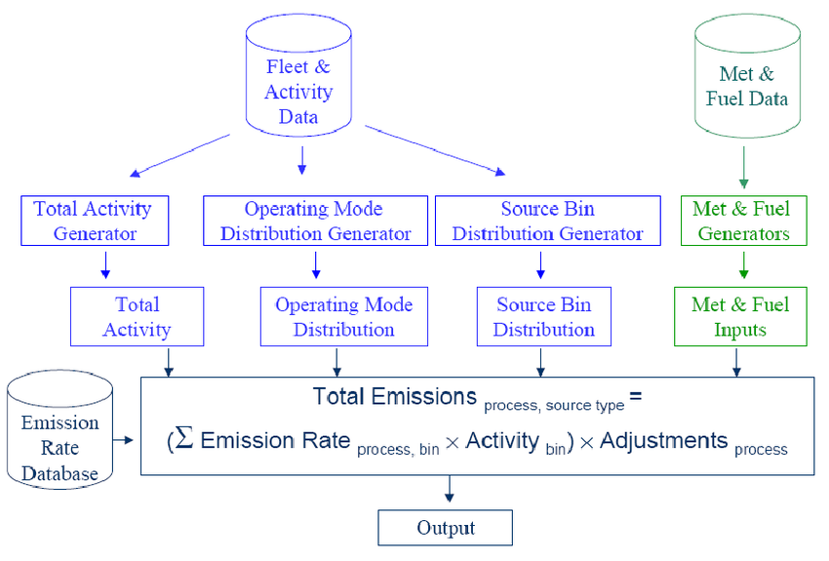
Surveys, energ. & emissions
Other fleet models……
9
Notes:
É energetic
9

Slide 10
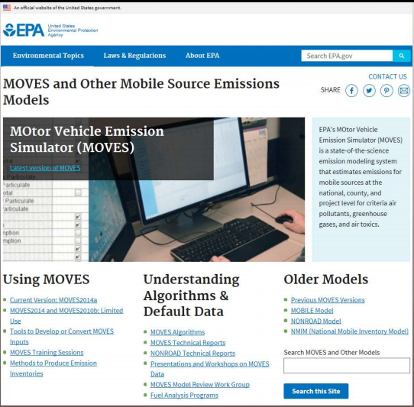
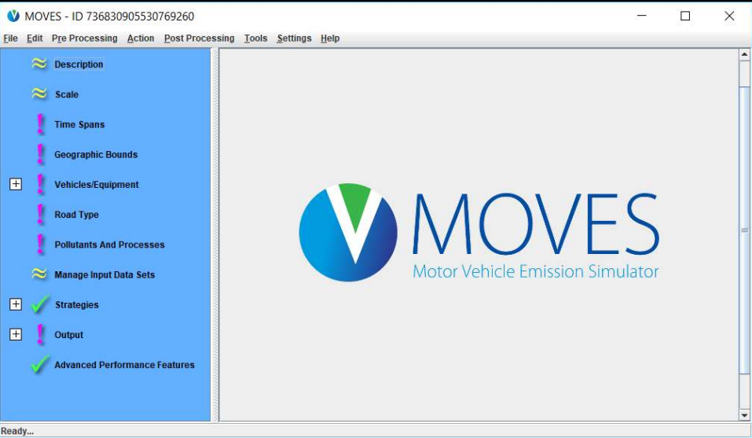
Surveys, energ. & emissions
Other fleet models……United States-free
10
Notes:
É energetic
10

Slide 11
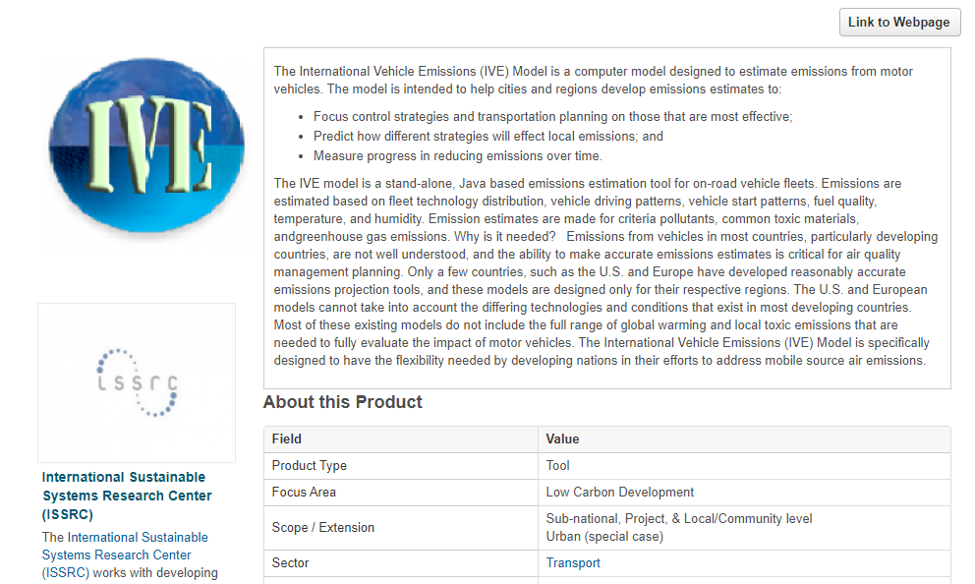
Surveys, energ. & emissions
Other fleet models……free-developing countries
11
Notes:
É energetic
11

Slide 12
Surveys, energ. & emissions
Other fleet models……free
12
Notes:
É energetic
12

Slide 13
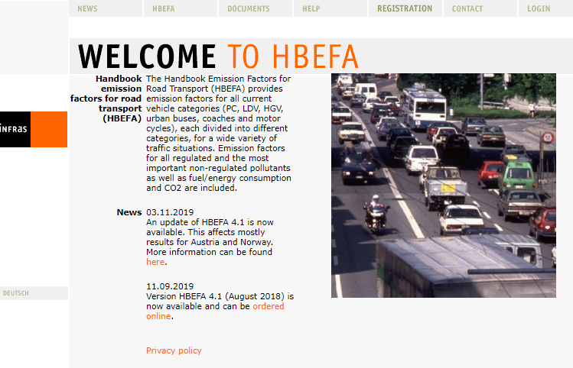
Surveys, energ. & emissions
Emission factors database……250 euros-
13
Notes:
É energetic
13

Slide 14
Surveys, energ. & emissions
Other fleet models……HBEFA
14
Notes:
É energetic
14

Slide 15
Surveys, energ. & emissions
Other fleet models……HBEFA
Original: Germany, Switzerland and Austria.
In the meantime, further countries
Sweden
Norway
France as well as the JRC (European Research Center of the European Commission) are supporting HBEFA.
15
Notes:
É energetic
15

Slide 16
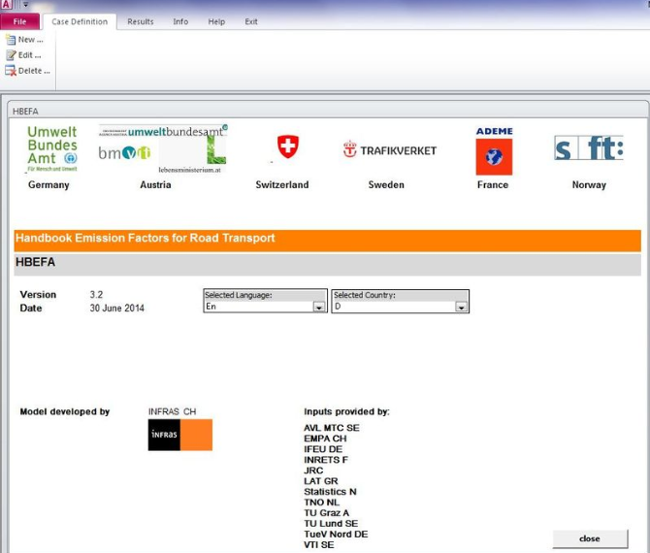
Surveys, energ. & emissions
Other fleet models……HBEFA
16
Notes:
É energetic
16

Slide 17
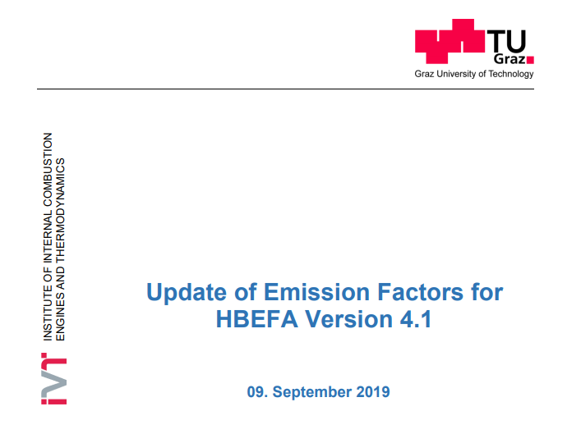
Surveys, energ. & emissions
Other fleet models……HBEFA
https://www.hbefa.net/e/documents/HBEFA41_Report_TUG_09092019.pdf
17
Notes:
É energetic
17

Slide 18
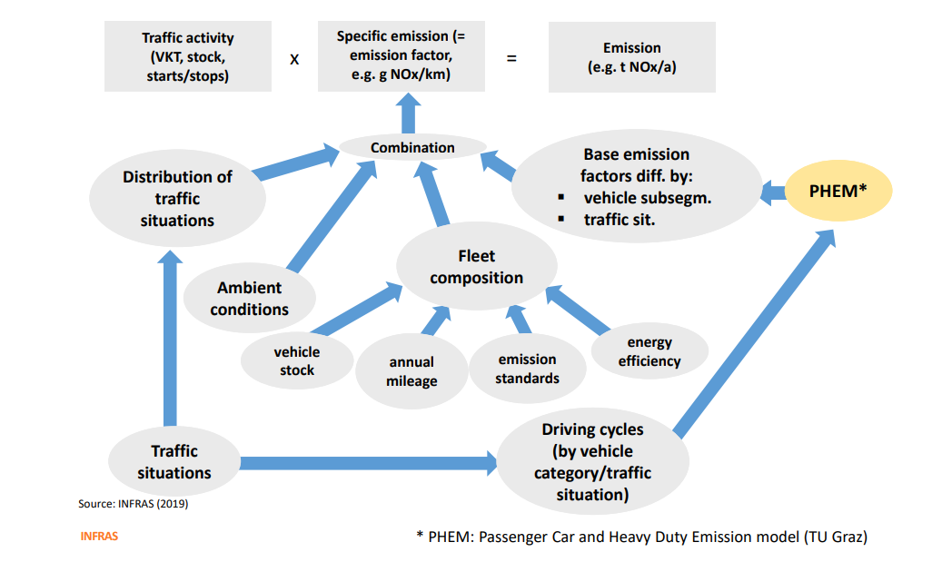
Surveys, energ. & emissions
Other fleet models……HBEFA
18
Notes:
É energetic
18

Slide 19
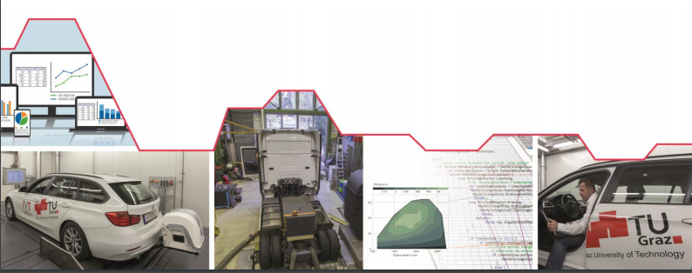
Surveys, energ. & emissions
Other fleet models……HBEFA
https://www.hbefa.net/e/documents/HBEFA41_Report_TUG_09092019.pdf
19
Notes:
É energetic
19

Slide 20
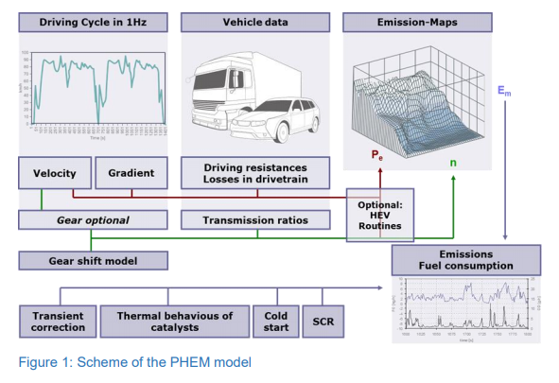
Surveys, energ. & emissions
Other fleet models……HBEFA
https://www.hbefa.net/e/documents/HBEFA41_Report_TUG_09092019.pdf
20
Notes:
É energetic
20

Slide 21
Surveys, energ. & emissions
Other fleet models……HBEFA
21
Notes:
É energetic
21

Slide 22
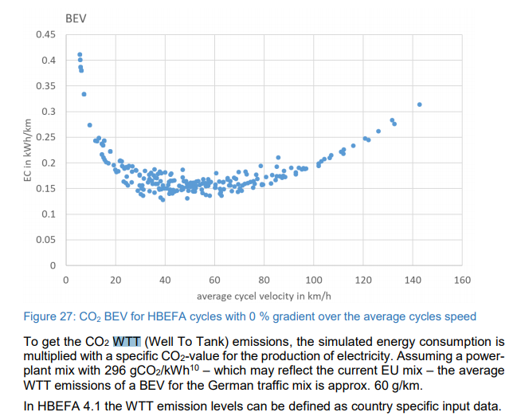
Surveys, energ. & emissions
Other fleet models……HBEFA
22
Notes:
É energetic
22

Slide 23
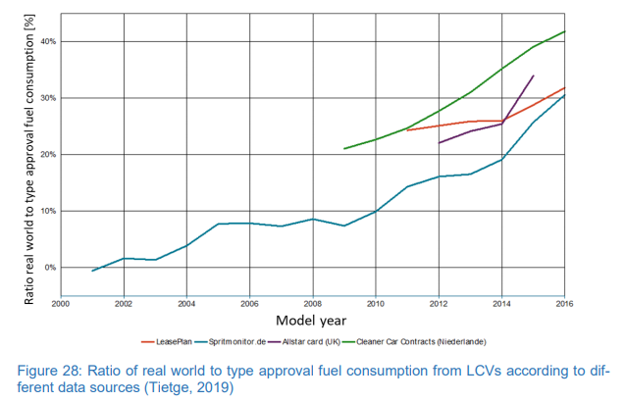
Surveys, energ. & emissions
Other fleet models……HBEFA
23
Notes:
É energetic
23

Slide 24
Surveys, energ. & emissions
Wtt DATA
European Platform on Life Cycle Assessment
ELCD3.0 latest version 2018
European reference Life Cycle Database
Emission factors per MWh of electricity production (NEEFEp)
24
Notes:
É energetic
24

Slide 25
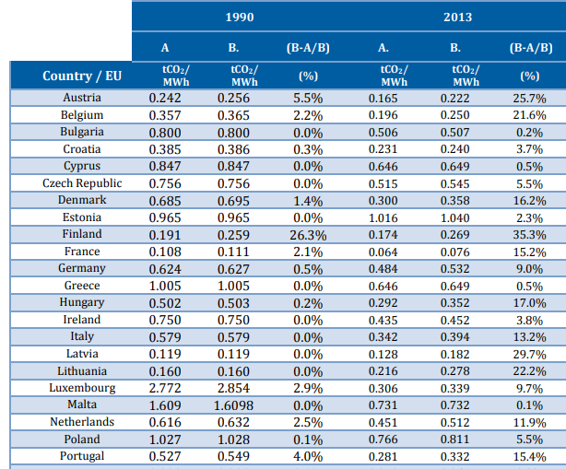
Surveys, energ. & emissions
Wtt DATA
A-w/o biofuels
B-w/ biofuels
25
Notes:
É energetic
25

Slide 26
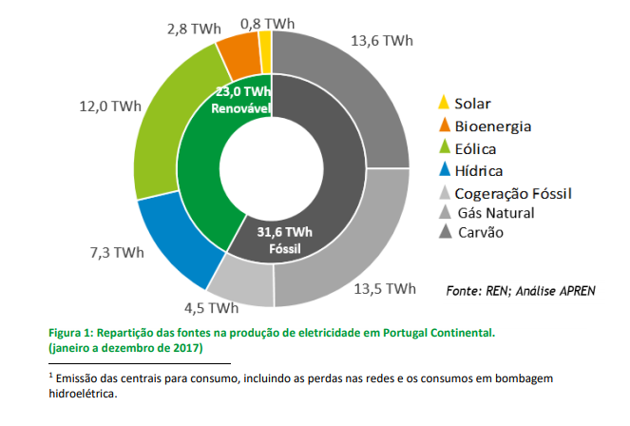
Surveys, energ. & emissions
Wtt DATA electricity CONSUMPTION PORTUGAL 2017
Overall electricity consumption in 2017: 49,638 GWh
Natural gas 13.5%
Coal 13.6%
Other fossil 4.5%
26
Notes:
É energetic
26

Slide 27
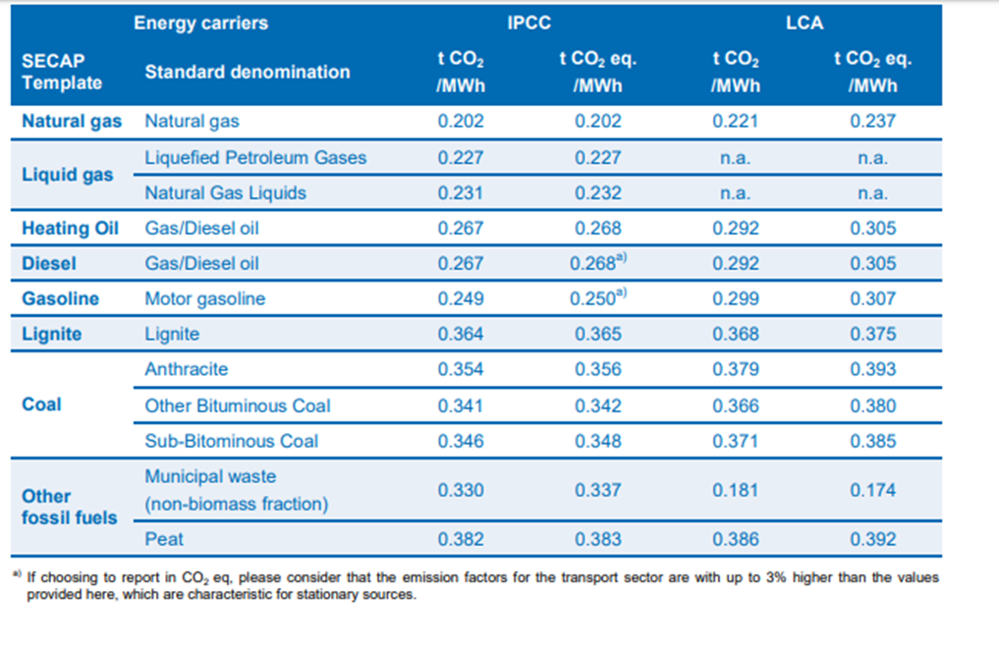
Surveys, energ. & emissions
Wtt DATA electricity CONSUMPTION PORTUGAL 2017
27
Notes:
É energetic
27

Slide 28
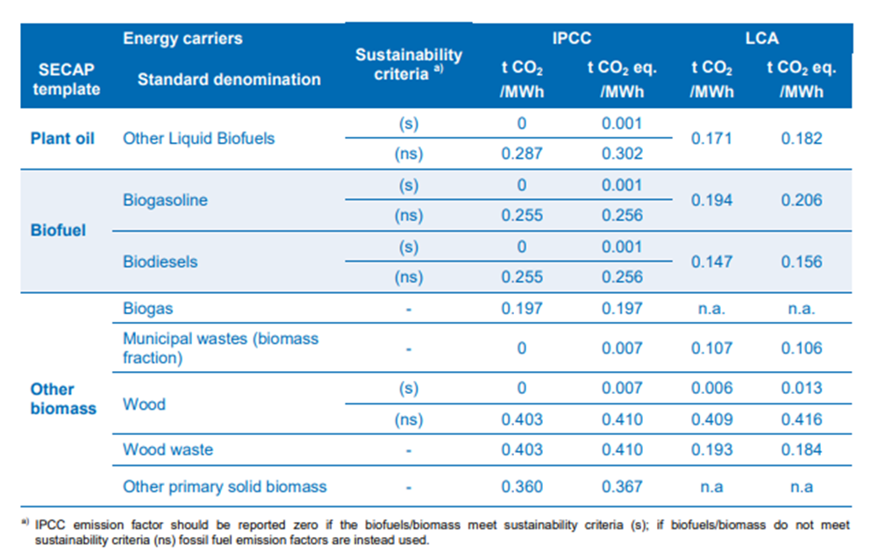
Surveys, energ. & emissions
Wtt DATA electricity CONSUMPTION PORTUGAL 2017
28
Notes:
É energetic
28

Slide 29
Surveys, energ. & emissions
Wtt DATA electricity CONSUMPTION PORTUGAL 2017
 |  |  |  | CO2eq | E3databse | https://www.covenantofmayors.eu/IMG/pdf/Covenant_ReportingGuidelines.pdf
 |  | % of total |  | g/kWh
other fossil | 4.5 | 0.082417582
coal | 13.6 | 0.249084249 |  | 386
natural gas | 13.5 | 0.247252747 |  | 237
biofuel/waste | 2.8 | 0.051282051 |  | 106
renwables | 23 | 0.421245421
Total | 54.6 | 1
grid | losses (%) | 6
 |  | Outlet kWh |  | powerplant kWh |  | gCO2eq
 |  | 1 |  | 1.063829787 |  | 170.4057
 |  | Overall grid factor
 |  | 170.4056582 | gCO2eq/kWh
29
Notes:
É energetic
29

Slide 30
FCUL survey ….

Slide 31
^{Obrigado}

